Slide 1
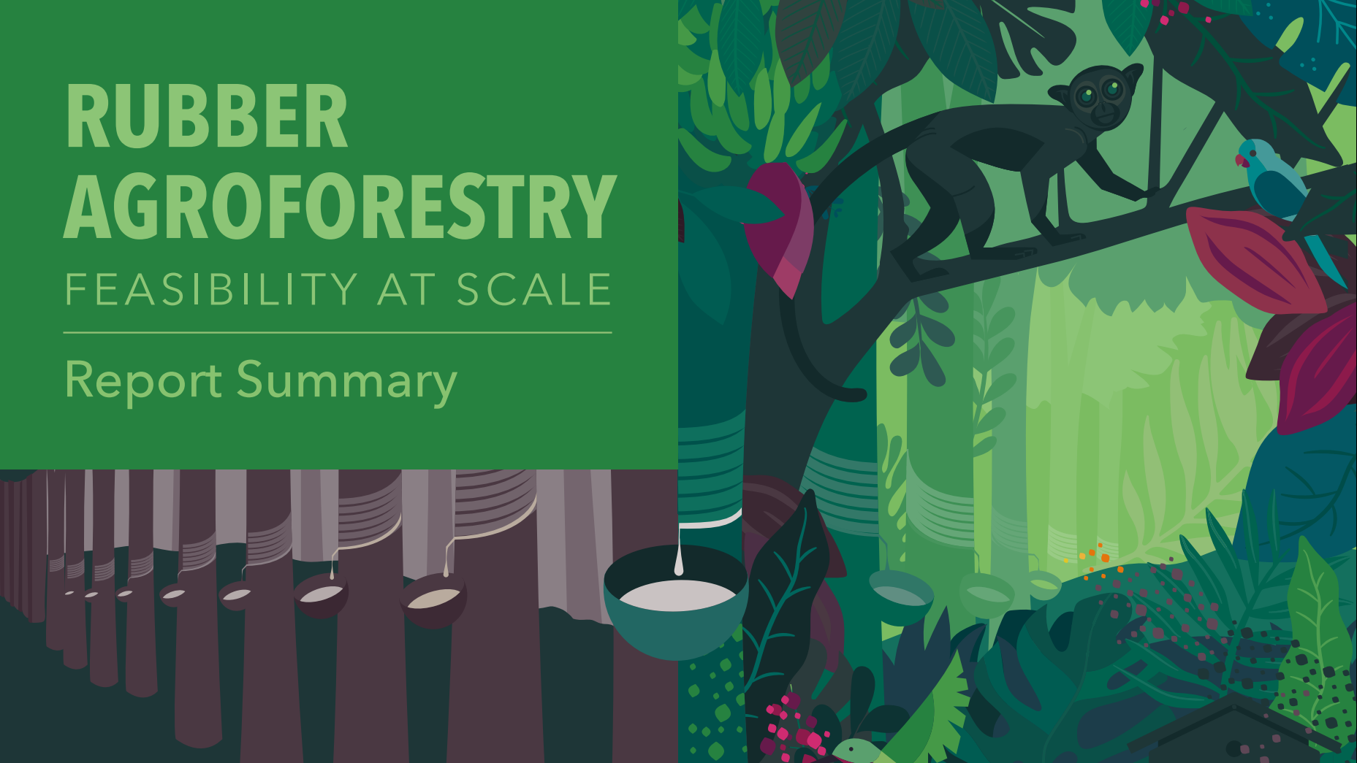
Assoc. Professor Thomas Cherico Wanger
Maria M.H. Wang MSc, Eleanor Warren-Thomas PhD & Thomas C. Wanger PhD
Westlake University, China &
Global Agroforestry Network
Agroforestry Session | GPSNR Meeting | 18.05.2021

Slide 2
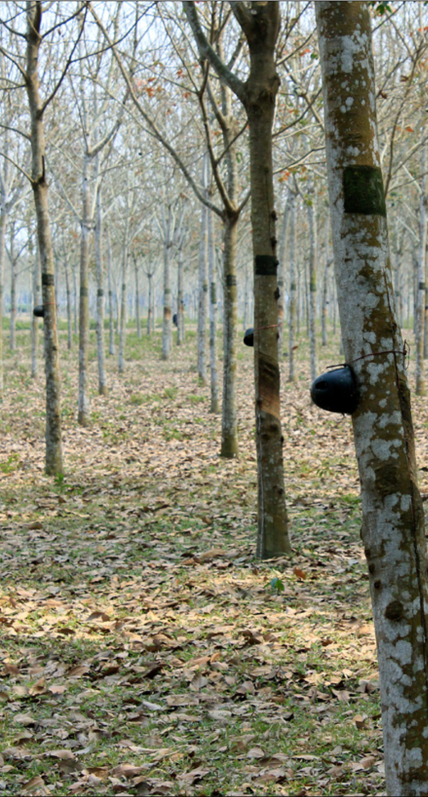
SIMPLE VS. DIVERSE RUBBER PRODUCTION
Monoculture production
Rubber is commonly cultivated as a monoculture in Southeast Asia
90% of natural rubber is produced by smallholder farmers
Intensive use of agrochemicals
Multiple social, economic and environmental challenges
Degradation of soils and freshwater resources
Deforestation
Increased disease and climate impact risk
Price fluctuations cause socioeconomic impacts on smallholders
1

Slide 3
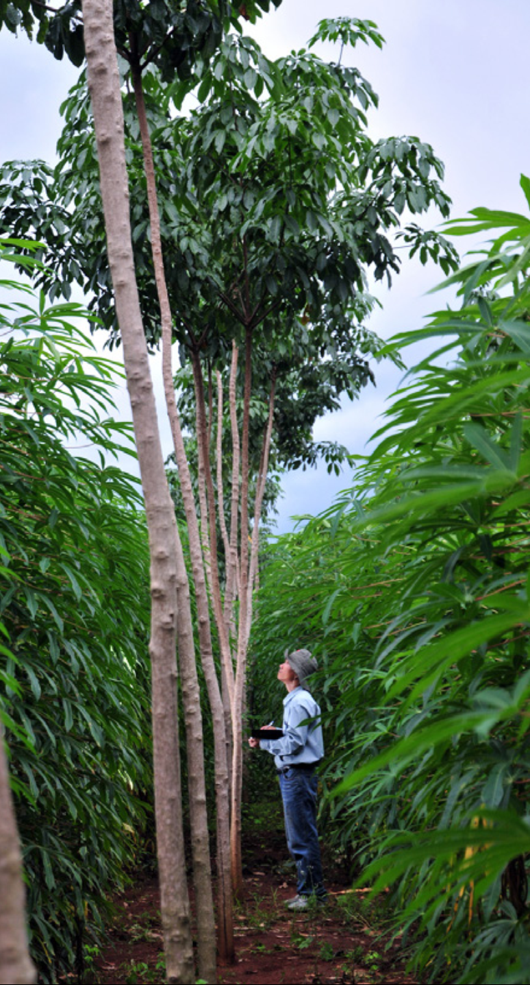
SIMPLE VS. DIVERSE RUBBER PRODUCTION
Agroforestry production
Agroforestry systems provide multiple ecological, social, and environmental benefits
No standard definition for rubber agroforestry
The Mighty Earth Rubber Agroforestry Report is the first comprehensive summary of effects in rubber
Based on literature review
Expert interviews
2

Slide 4
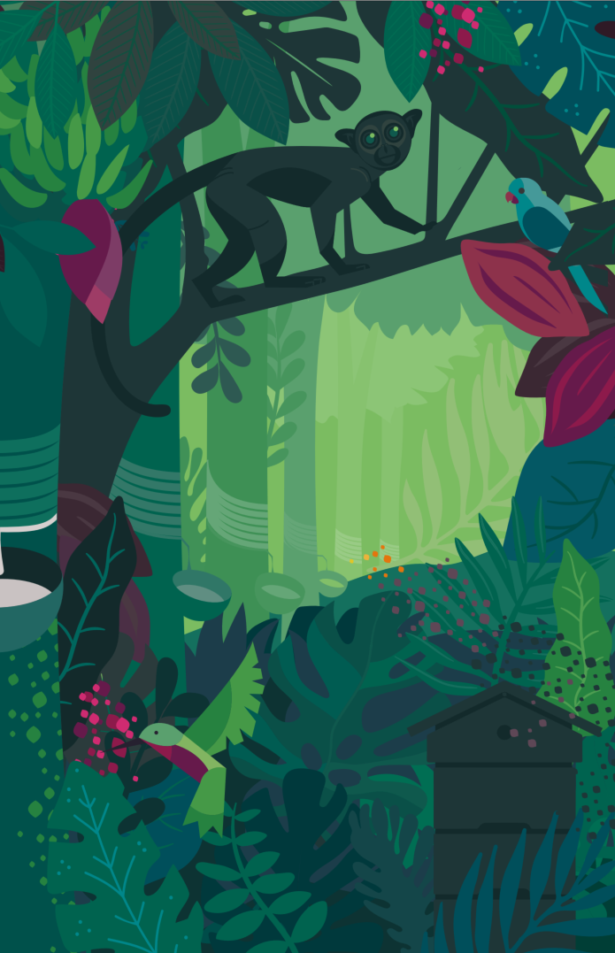
Rubber Agroforestry Report Typology

Slide 5
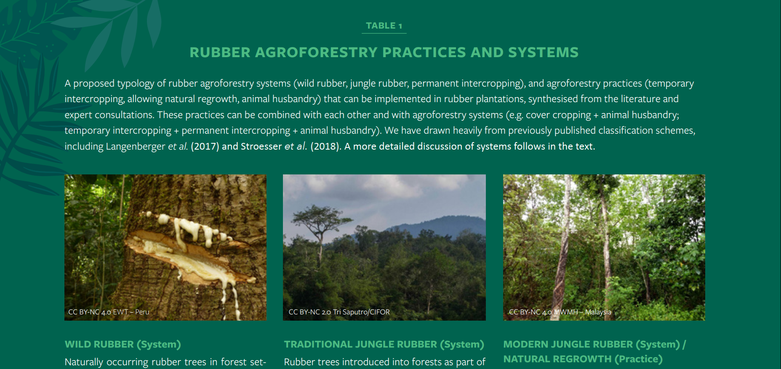
6
RUBBER AGROFORESTRY TYPOLOGY
4

Slide 6
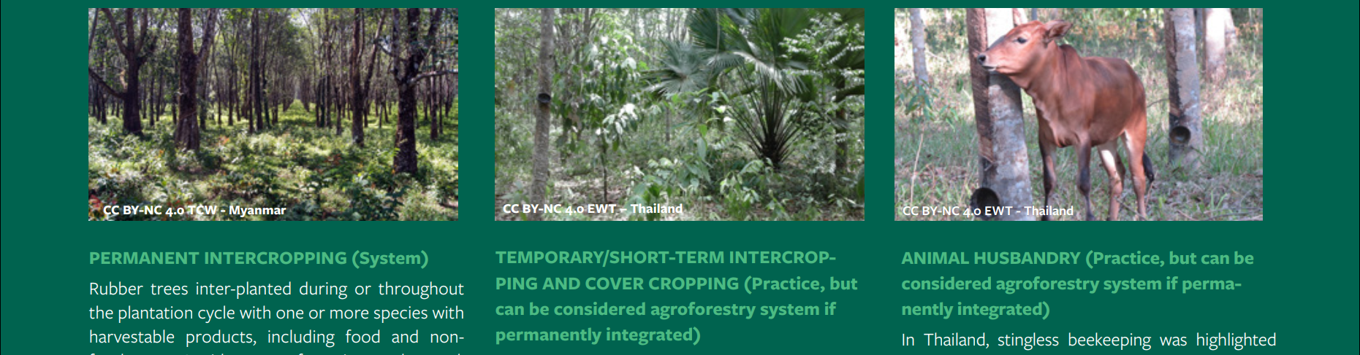
6
RUBBER AGROFORESTRY TYPOLOGY
4

Slide 7
Rubber Agroforestry Report Key Findings

Slide 8
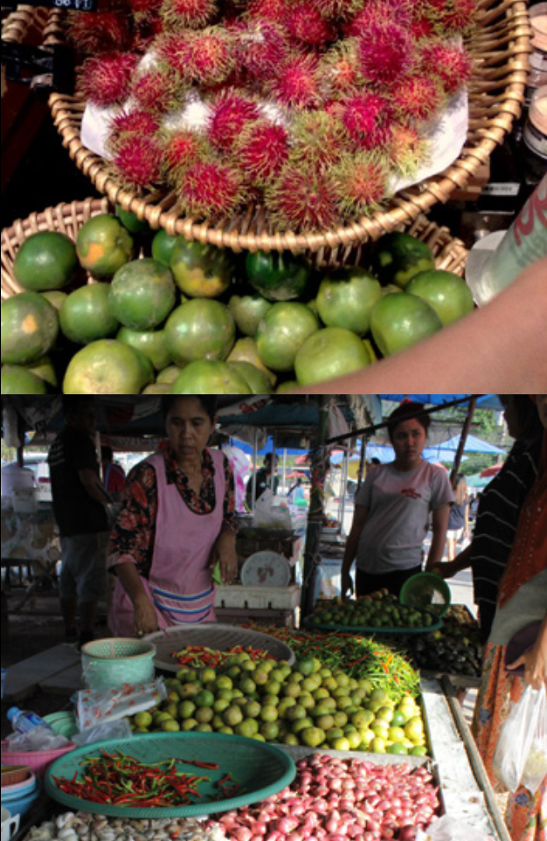
AGROFORESTRY CAN IMPROVE LIVELIHOODS
Smallholder income enhanced in rubber intercropping systems and with small-scale livestock farming
Latex yields generally unaffected by intercropping but tree growth depends on conditions
Rubber shade reduces intercrop yields but total plantation yields overall increased
Price premiums provided by buyers
6

Slide 9
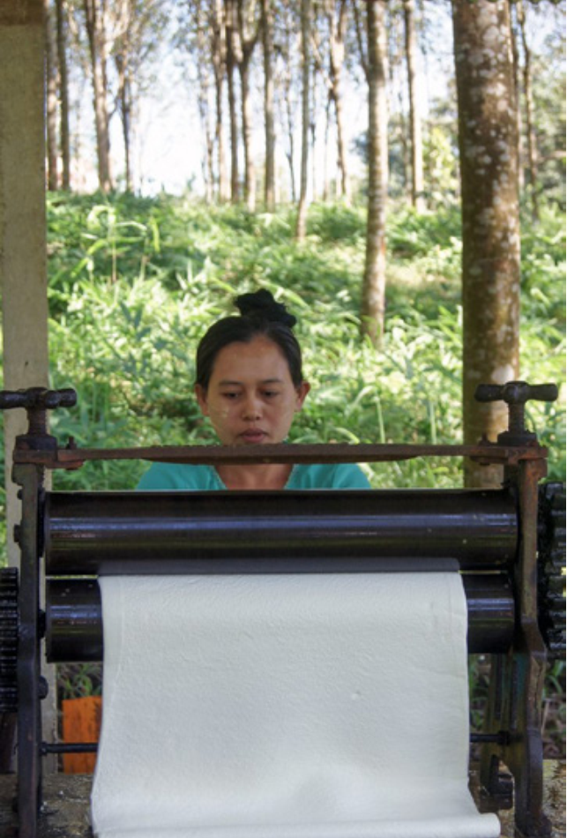
AGROFORESTRY CAN IMPROVE SOCIAL OUTCOMES
Improved farmer knowledge sharing
Rubber agroforestry strategies can be tailored to local gender roles and cultural preferences e.g. land-use decision making, tree planting activities
Agroforestry can also improve land tenure security for smallholder farmers compared to annual crops alone
7

Slide 10
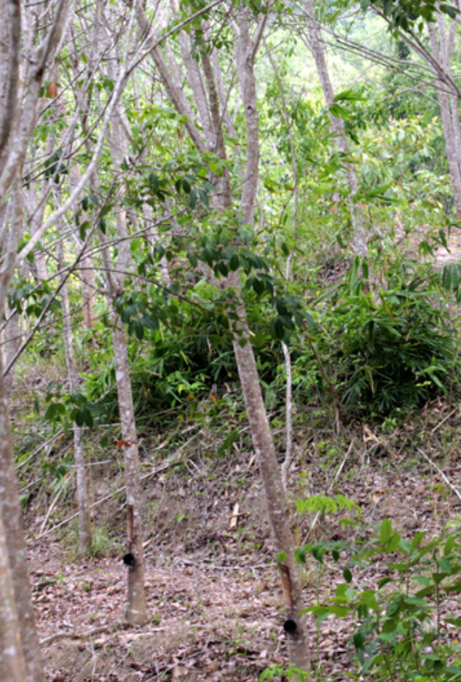
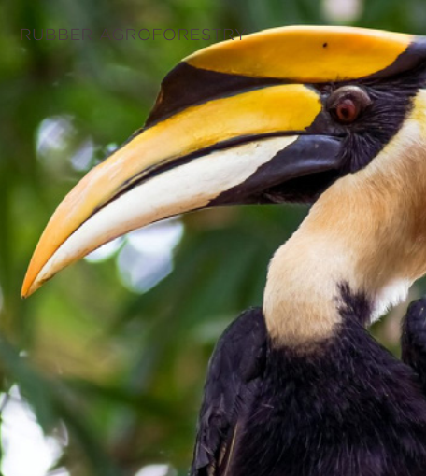
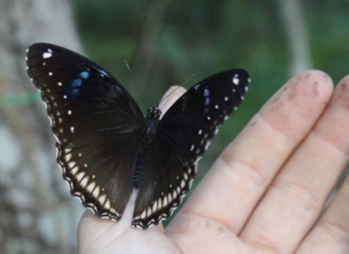
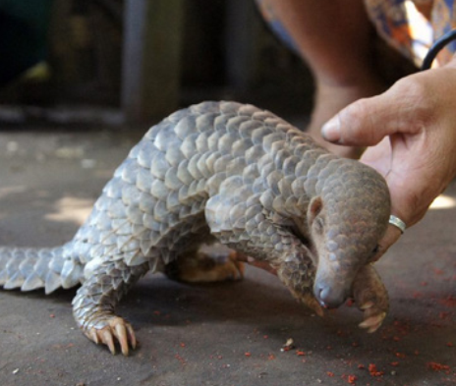
AGROFORESTRY CAN IMPROVE ENVIRONMENTAL OUTCOMES
Benefits to soil health: higher soil carbon, increased water infiltration, and reduced soil erosion
There is no evidence for water or nutrient competition (climate resilience)
Maintaining biodiversity by enhancing habitat connectivity
Various species benefit from rubber agroforestry
8

Slide 11
Rubber Agroforestry Report Recommendations

Slide 12
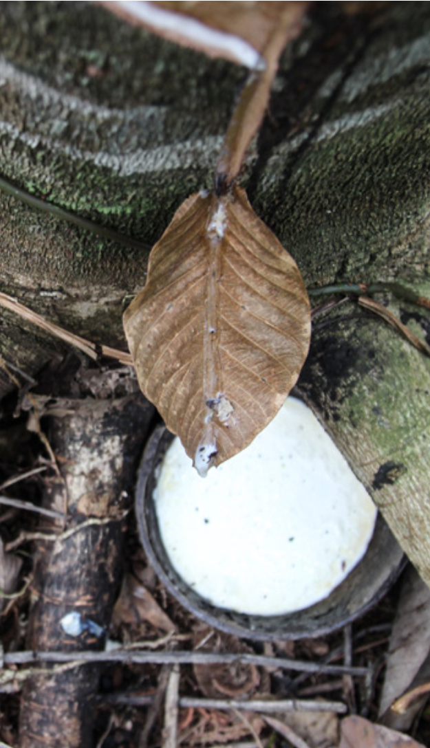
RECOMMENDATIONS FOR GOVERNMENT POLICIES
Deliver consistent policy and support interventions that favor agroforestry practices and encourage reductions in chemical inputs e.g. subsidies, technical recommendations
Initiate progressive land rights and tenure reform policies to incentivize smallholders’ investments
10

Slide 13
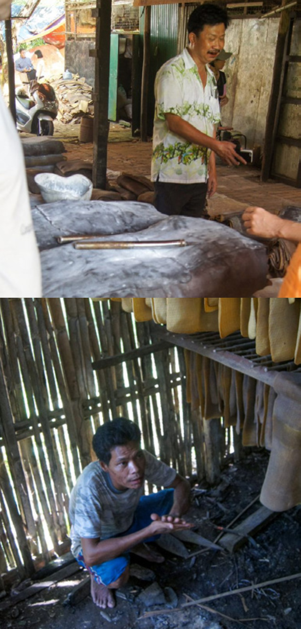
RECOMMENDATIONS FOR INDUSTRIAL AND LARGE PLANTATION OWNERS
Recognize and develop low chemical input agroforestry as cost-effective strategy towards sustainable production
Trial agroforestry methods on a portion of estate (e.g. when replanting) and replicate successful approaches
Actively support rubber intercropping as part of out-grower schemes
Utilize temporary intercropping between rubber rows during first three years of rubber establishment
11

Slide 14
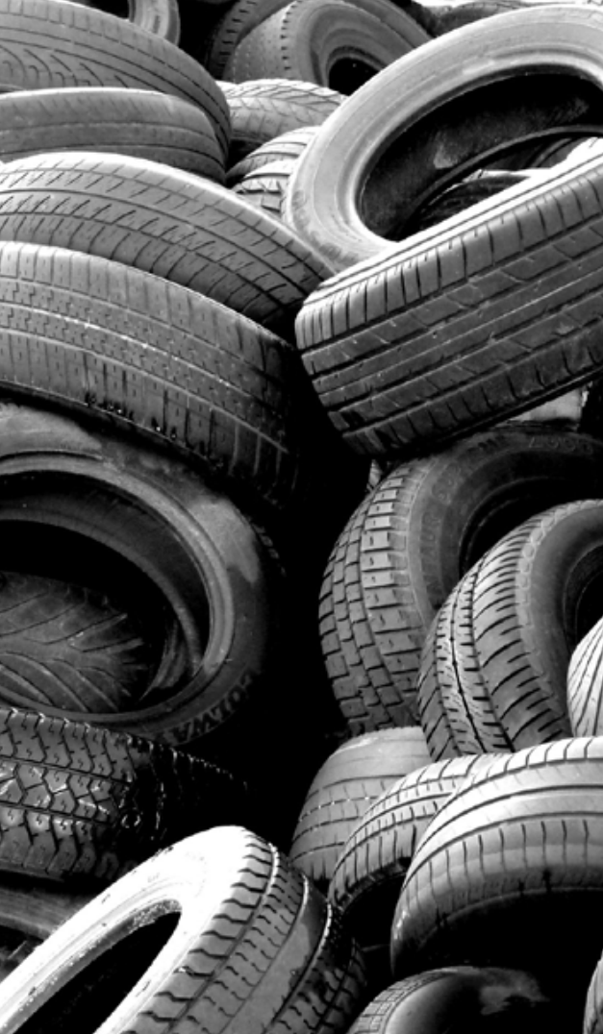
RECOMMENDATIONS FOR RUBBER BUYERS
Facilitate the adoption of agroforestry rubber by creating a demand for sustainable rubber through procurement policies
Provide a price premium for smallholders and industrial growers who implement agroforestry and other sustainable practices
12

Slide 15
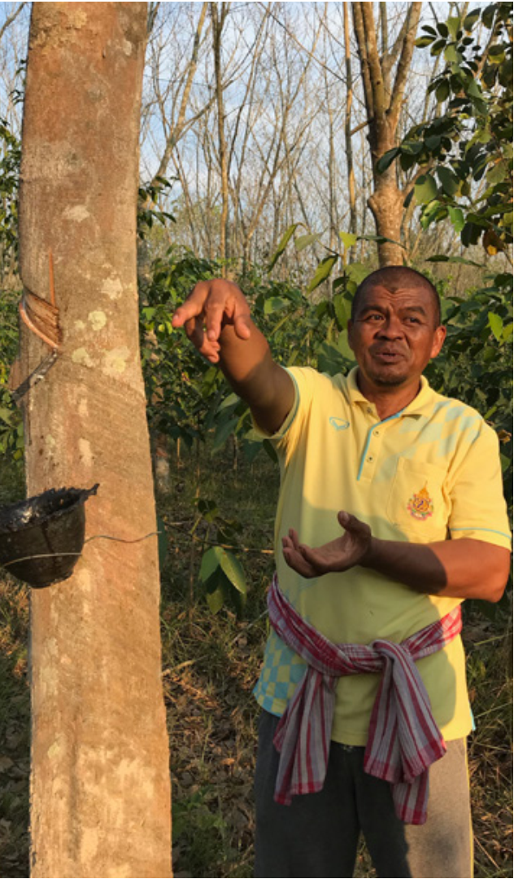
RECOMMENDATIONS FOR RESEARCHERS AND CIVIL SOCIETY
Co-produce well-evidenced agroforestry knowledge with smallholders, plantations and all rubber supply chain actors
Uplift smallholder farmer and indigenous knowledge by highlighting those in their work
Support farmer-to-farmer networks, co-ops and local grower associations
13

Slide 16
Conclusions
Considerable existing knowledge around agroforestry benefits: the need to take action now to support agroforestry is urgent
Develop context-dependent best practices for agroforestry
- constraints of local biophysical environment
- market availability
- smallholder needs and constraints
- agroforestry objectives
14

Slide 17

Acknowledgements
This presentation and the report are based on joint work by Maria M.H. Wang, Eleanor Warren-Thomas & Thomas C. Wanger.
We thank Mighty Earth for the opportunity to prepare the report and hope that our work will contribute towards more sustainable rubber production globally.
We are grateful to the expert interviewees for their time, and to farmer networks in Southern Thailand who participated in previous research.
We thank Heather Weiss and Alex Wijeratna for editing this report, and Dr Julian Oram, Margaret Kran-Annexstein and Aiyana Bodi for their input.
Cecily Anderson (www.anagramdesignstudio.com) provided the design, monkey and leopard assets from allfreedownload.com.

Slide 19
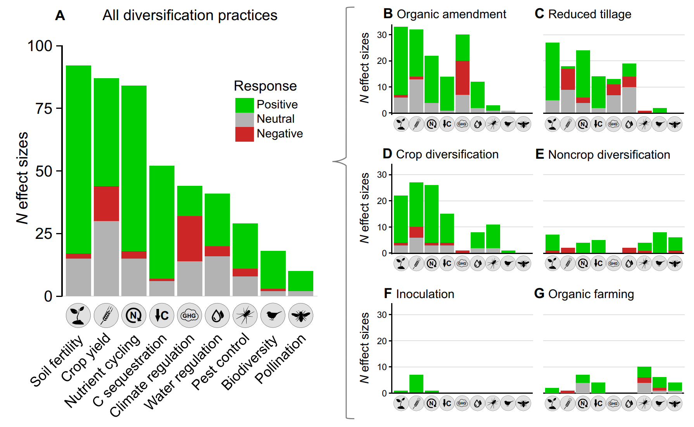
AGRICULTURAL DIVERSIFICATION:
POSITIVE EFFECTS ON ECOSYSTEM SERVICES AND YIELDS
Integrating 98 Meta-Analyses or 3 decades of research
Tamburini et al. 2020 Science Advances

